Slide 1
Software Project Lab-1
Submitted by: Supervised:
Md. Khayrul Islam Sajib Dr. B M Mainul Hossain
Roll : BSSE 1552 (Professor & Director), IIT

Slide 2
Project name: Image Manipulation/Processing
Language used:
C/C++
Github-Hyperlink-SPL-1

Slide 3
What is image processing
Image processing is a method to perform some operations on an image, in order to get an enhanced image or to extract some useful information from it.
Goal: Enhance or analyze images for various applications across different fields.

Slide 4
Importance of Image Processing
Medical Imaging: Enhancing medical scans for diagnosis.
Computer Vision: Enabling machines to interpret visual information
Satellite Imaging: Extracting valuable data from satellite images.
Entertainment: Enhancing and editing images in photography and film

Slide 5
Project Motivation
Want to explore the image manipulation side of the technology field
Make images more informative and engaging.
Extract meaningful information from images.
Try to understand bit operation inside pixels
Manipulating an image to extract information or enhance features.
Want to work on a bigger project which will require rigorous work on image
manipulation

Slide 6
Project Objective
Deliver a fully functional software with interactive user interface
Edit a 24-bit bitmap image
Completion of basic image processing operations
Apply ten image processing algorithms to an image
Successful resolution of a specific image processing challenge
Save an edited image for future purposes

Slide 7
Features
Supported Operations:
Read BMP Image.
Negative Transformation.
Grayscale Conversion.
Brightening and Darkening.
Export BMP File.
Planned Operations (Future Scope):
Smoothing, Sharpening, Gaussian Blur, and Sobel Edge Detection.

Slide 8
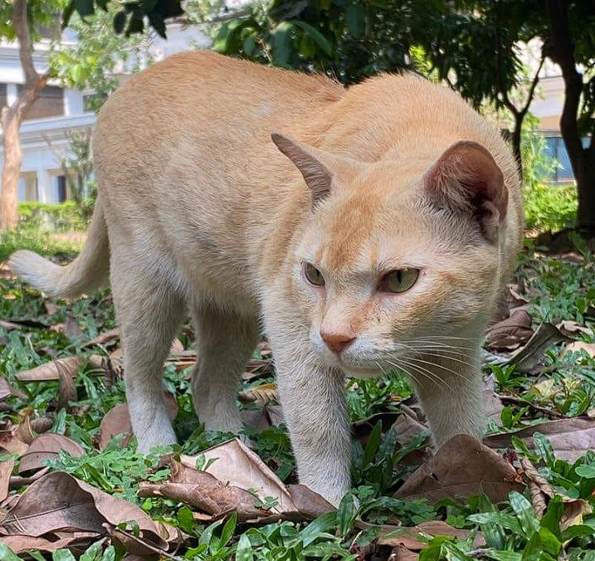
Reading an Image
Reading the lala.bmp image as input
Reading header info
Reading pixel data
Storing the data in structure variables

Slide 9
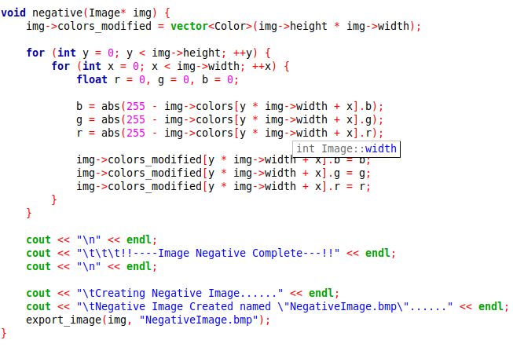
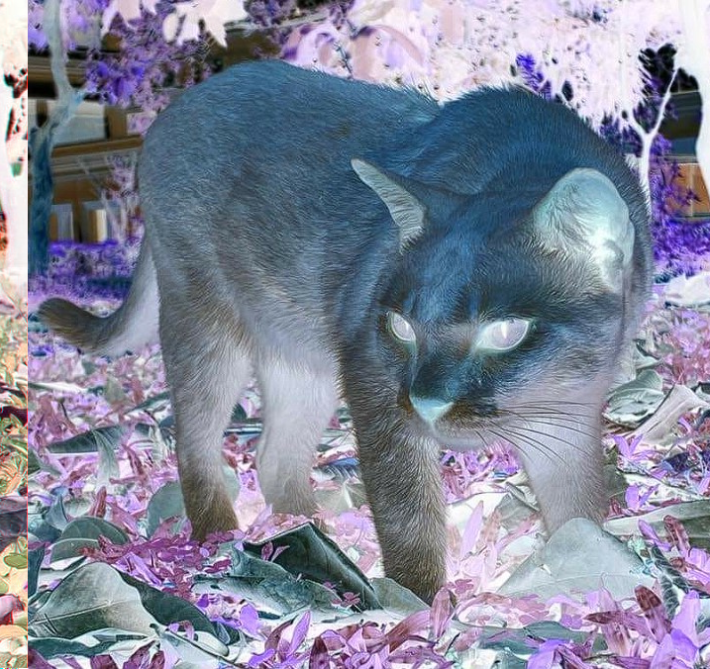
Negative Image
The negative of an image by inverting the RGB color values for every pixel.
Each color component (r, g, b) is inverted by subtracting its value from 255.
Negative Value= (255 − Original Value)
For example:
If r = 50, the inverted value is 255 - 50 = 205
Effect:
The result of this loop is that the colors_modified array now holds the negative of the original image.
The original image remains untouched, allowing the program to retain both versions if needed.

Slide 10
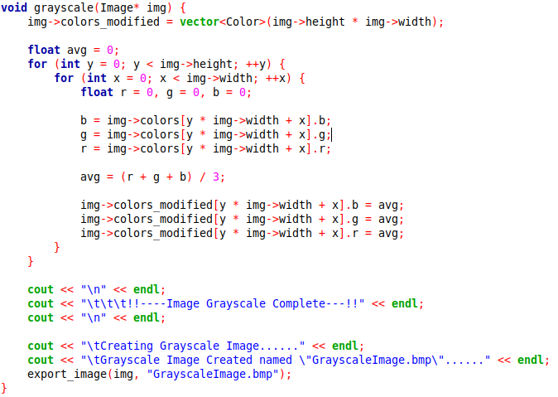
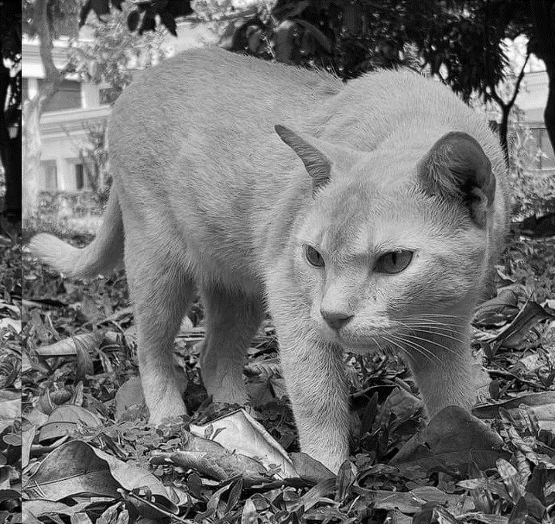
Grayscale Image
Purpose
The goal is to compute a grayscale version of the image by averaging the red (r), green (g), and blue (b) components of each pixel.
All three color channels (r, g, b) have the same value for a pixel.
This value represents the intensity of gray (black = 0, white = 255).
The average of the red, green, and blue values is calculated:
Avg = (r + g + b) / 3;
This value represents the intensity of gray for the pixel.
Effect
By assigning the same value (avg) to all three channels (r, g, b) for every pixel:
The original colors are replaced with their grayscale equivalent.
The resulting image will have no color, only varying shades of gray.

Slide 11
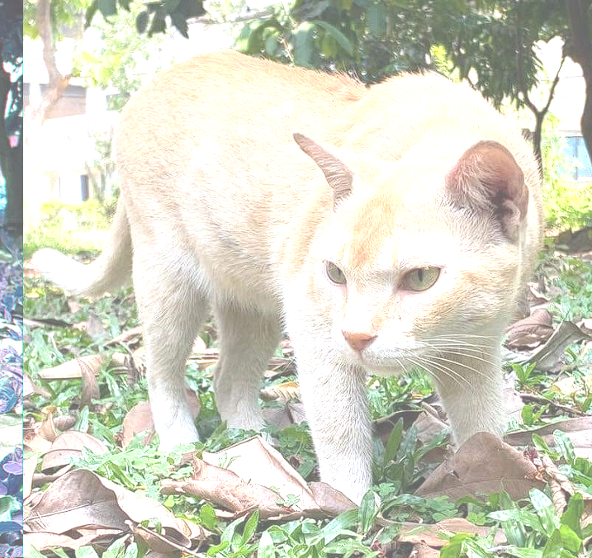
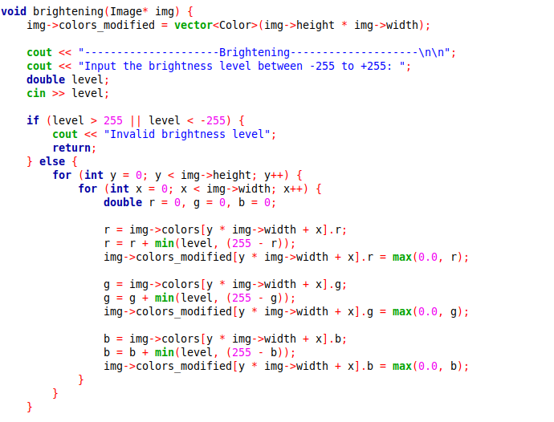
Brightening

Slide 12
Writing the Processed Image
Opening a new file in writing mode
Writing header info
Writing the modified pixel data
Closing the file

Slide 13
Challenges & Solutions
Challenges:
Reading and writing BMP files.
Managing memory for dynamic images.
Solutions:
Implemented padding handling for BMP format.
Modular functions for operations.

Slide 14
Future Scopes
Every tool is implemented as a function, these functions can be used as a part of other image
processing projects
More tools can be added to the software
Software can be used as a part of a bigger image processing project

Slide 15
Thanks

